Slide 1

CSE-217: Theory of Computation
Md. Jakaria
Lecturer
Dept. of CSE, MIST

Slide 2




Regular Expression Example -1
Build an NFA from the regular expression ${(a ∪ b)}^{∗}aba$
$$a$$
a
b
$$b$$
є
a
$$a ∪ b$$
b
є
є
є
a
$${(a ∪ b\text{)}}^{∗}$$
є
b
є
є
CSE 217: Theory of Computation

Slide 3
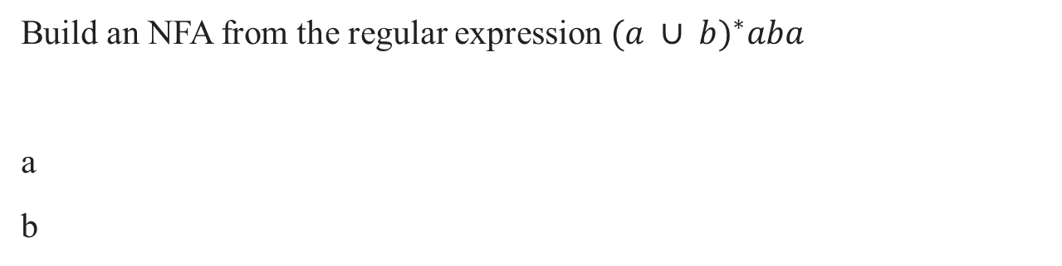


Regular Expression Example -1
Build an NFA from the regular expression ${(a ∪ b)}^{∗}aba$
a
b
a
b
a
є
b
$$ab$$
a
є
b
є
a
$$aba$$
CSE 217: Theory of Computation

Slide 4



Regular Expression Example -1
Build an NFA from the regular expression ${(a ∪ b)}^{∗}aba$
є
є
a
є
$${(a ∪ b\text{)}}^{∗}$$
b
є
є
a
є
b
є
a
$$aba$$
є
є
a
є
b
є
є
є
є
a
є
b
є
a
$${(a ∪ b\text{)}}^{∗}aba$$
є
CSE 217: Theory of Computation

Slide 5
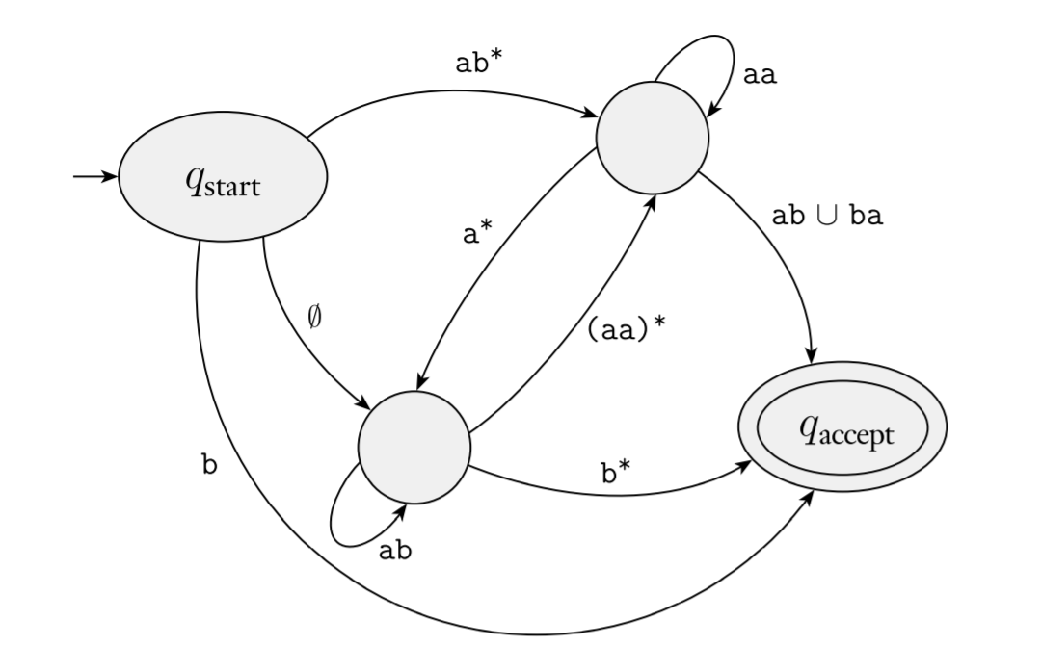
Converting DFA into Regular Expression
We break this procedure into two parts:
Create generalized nondeterministic finite automaton, GNFA
Convert a GNFA into a Regular Expression
CSE 217: Theory of Computation

Slide 6
Converting DFA into Regular Expression
Create generalized nondeterministic finite automaton, GNFA
For convenience, we require that GNFAs always have a special form that meets the following conditions.
The start state has transition arrows going to every other state but no arrows coming in from any other state.
There is only a single accept state, and it has arrows coming in from every other state but no arrows going to any other state. Furthermore, the accept state is not the same as the start state.
Except for the start and accept states, one arrow goes from every state to every other state and also from each state to itself.
CSE 217: Theory of Computation

Slide 7
Converting DFA into Regular Expression
Create generalized nondeterministic finite automaton, GNFA
For convenience, we require that GNFAs always have a special form that meets the following conditions.
The start state has transition arrows going to every other state but no arrows coming in from any other state.
There is only a single accept state, and it has arrows coming in from every other state but no arrows going to any other state. Furthermore, the accept state is not the same as the start state.
Except for the start and accept states, one arrow goes from every state to every other state and also from each state to itself.
We can easily convert a DFA into a GNFA in the special form. We simply add anew start state with an ε arrow to the old start state and a new accept state with ε arrows from the old accept states.
CSE 217: Theory of Computation

Slide 8
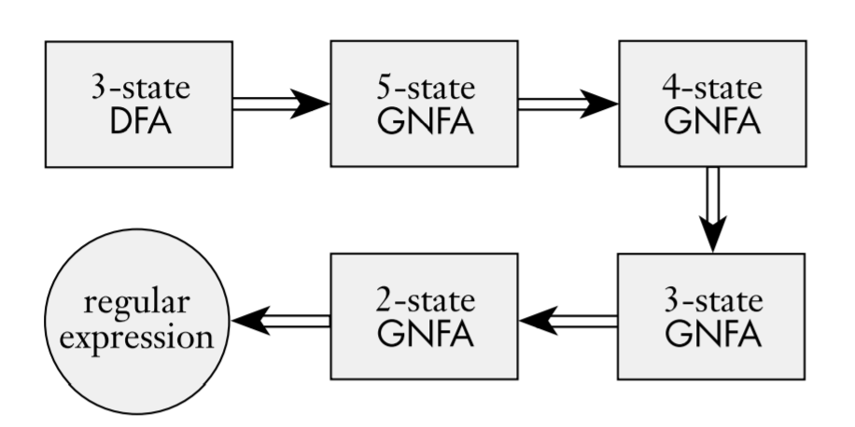
Converting DFA into Regular Expression
Convert a GNFA into a Regular Expression
CSE 217: Theory of Computation

Slide 9
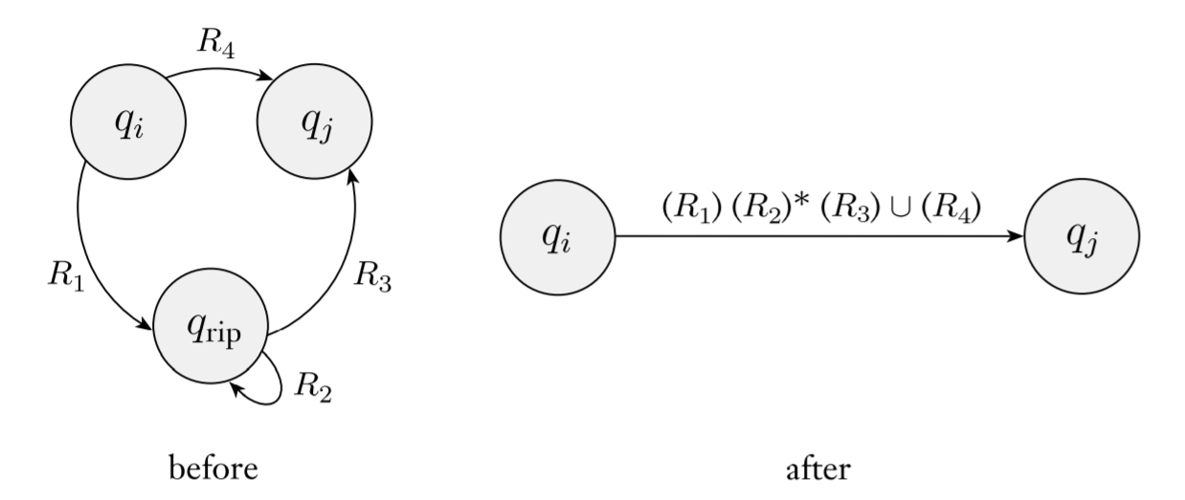
Converting DFA into Regular Expression
Convert a GNFA into a Regular Expression
CSE 217: Theory of Computation

Slide 10
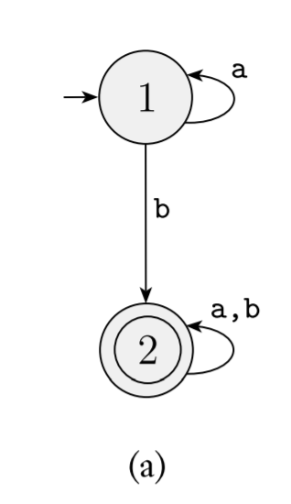
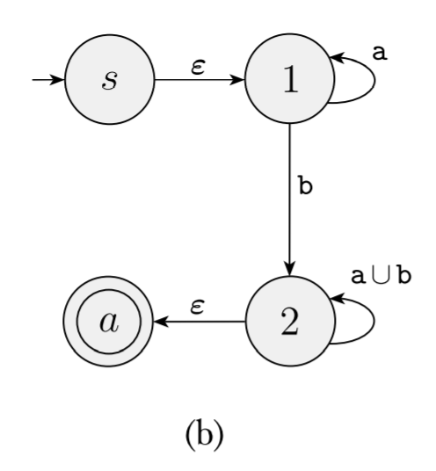
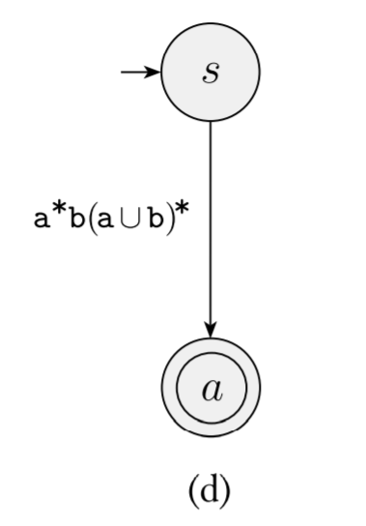
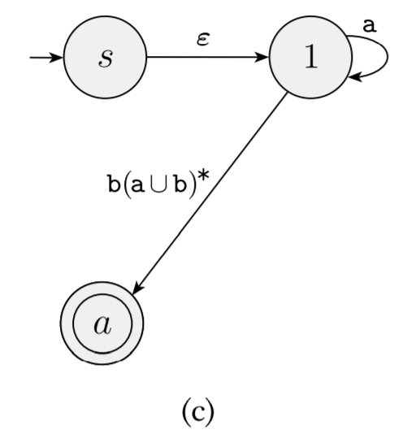
Example - 1
Converting a two-state DFA to an equivalent regular expression.
CSE 217: Theory of Computation

Slide 11
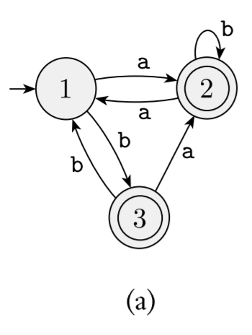
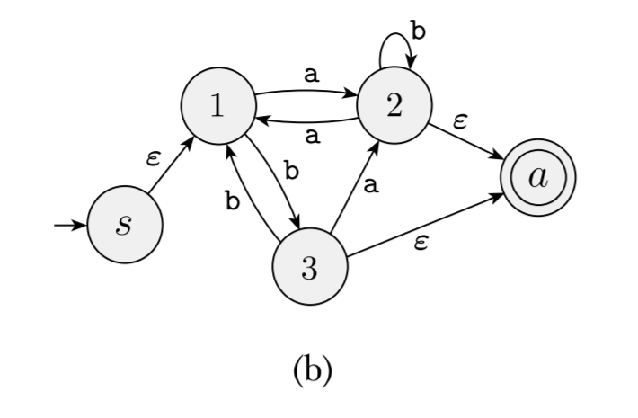
Example - 2
Converting a three-state DFA to an equivalent regular expression.
CSE 217: Theory of Computation

Slide 12
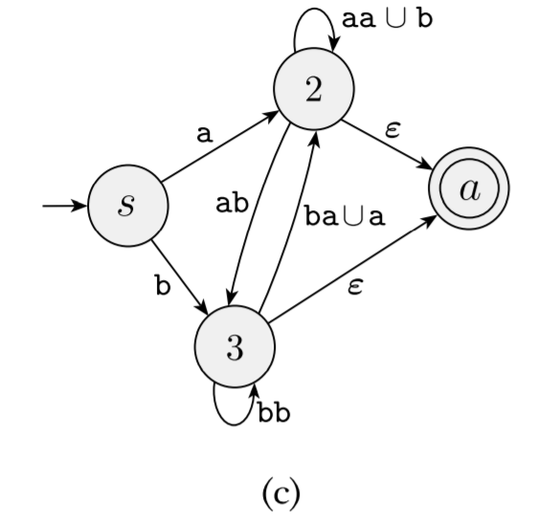
Example - 2
Converting a three-state DFA to an equivalent regular expression.
CSE 217: Theory of Computation

Slide 13
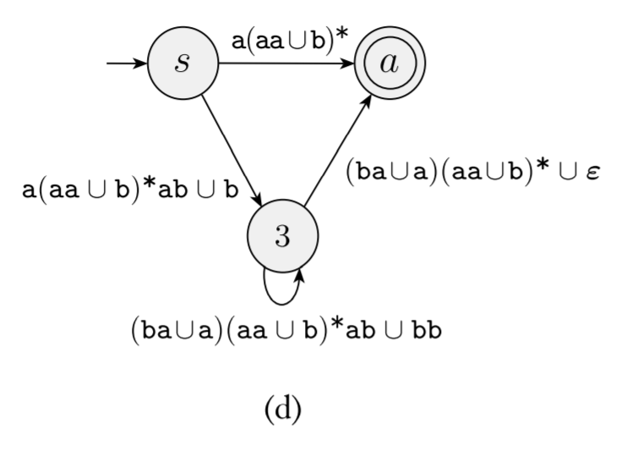
Example - 2
Converting a three-state DFA to an equivalent regular expression.
CSE 217: Theory of Computation

Slide 14
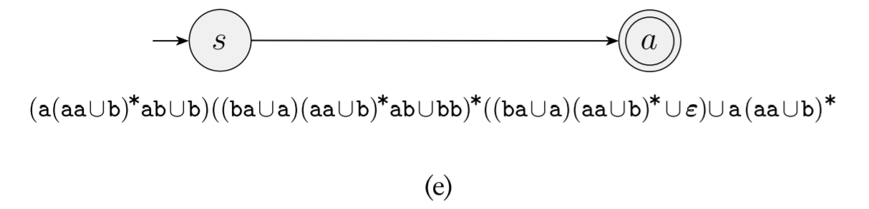
Example - 2
Converting a three-state DFA to an equivalent regular expression.
CSE 217: Theory of Computation

